Slide 1

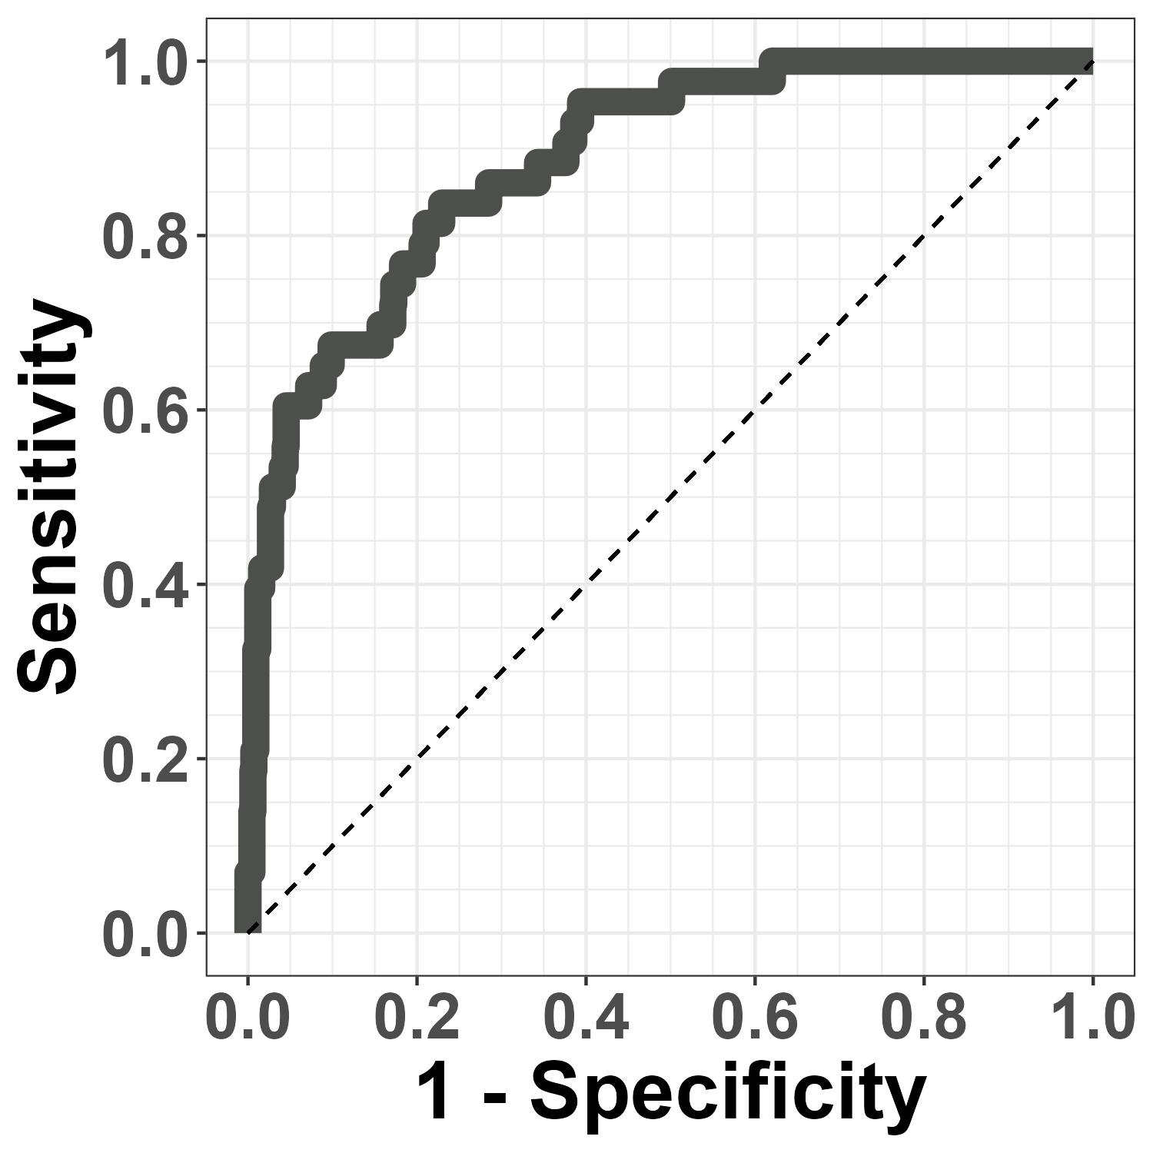
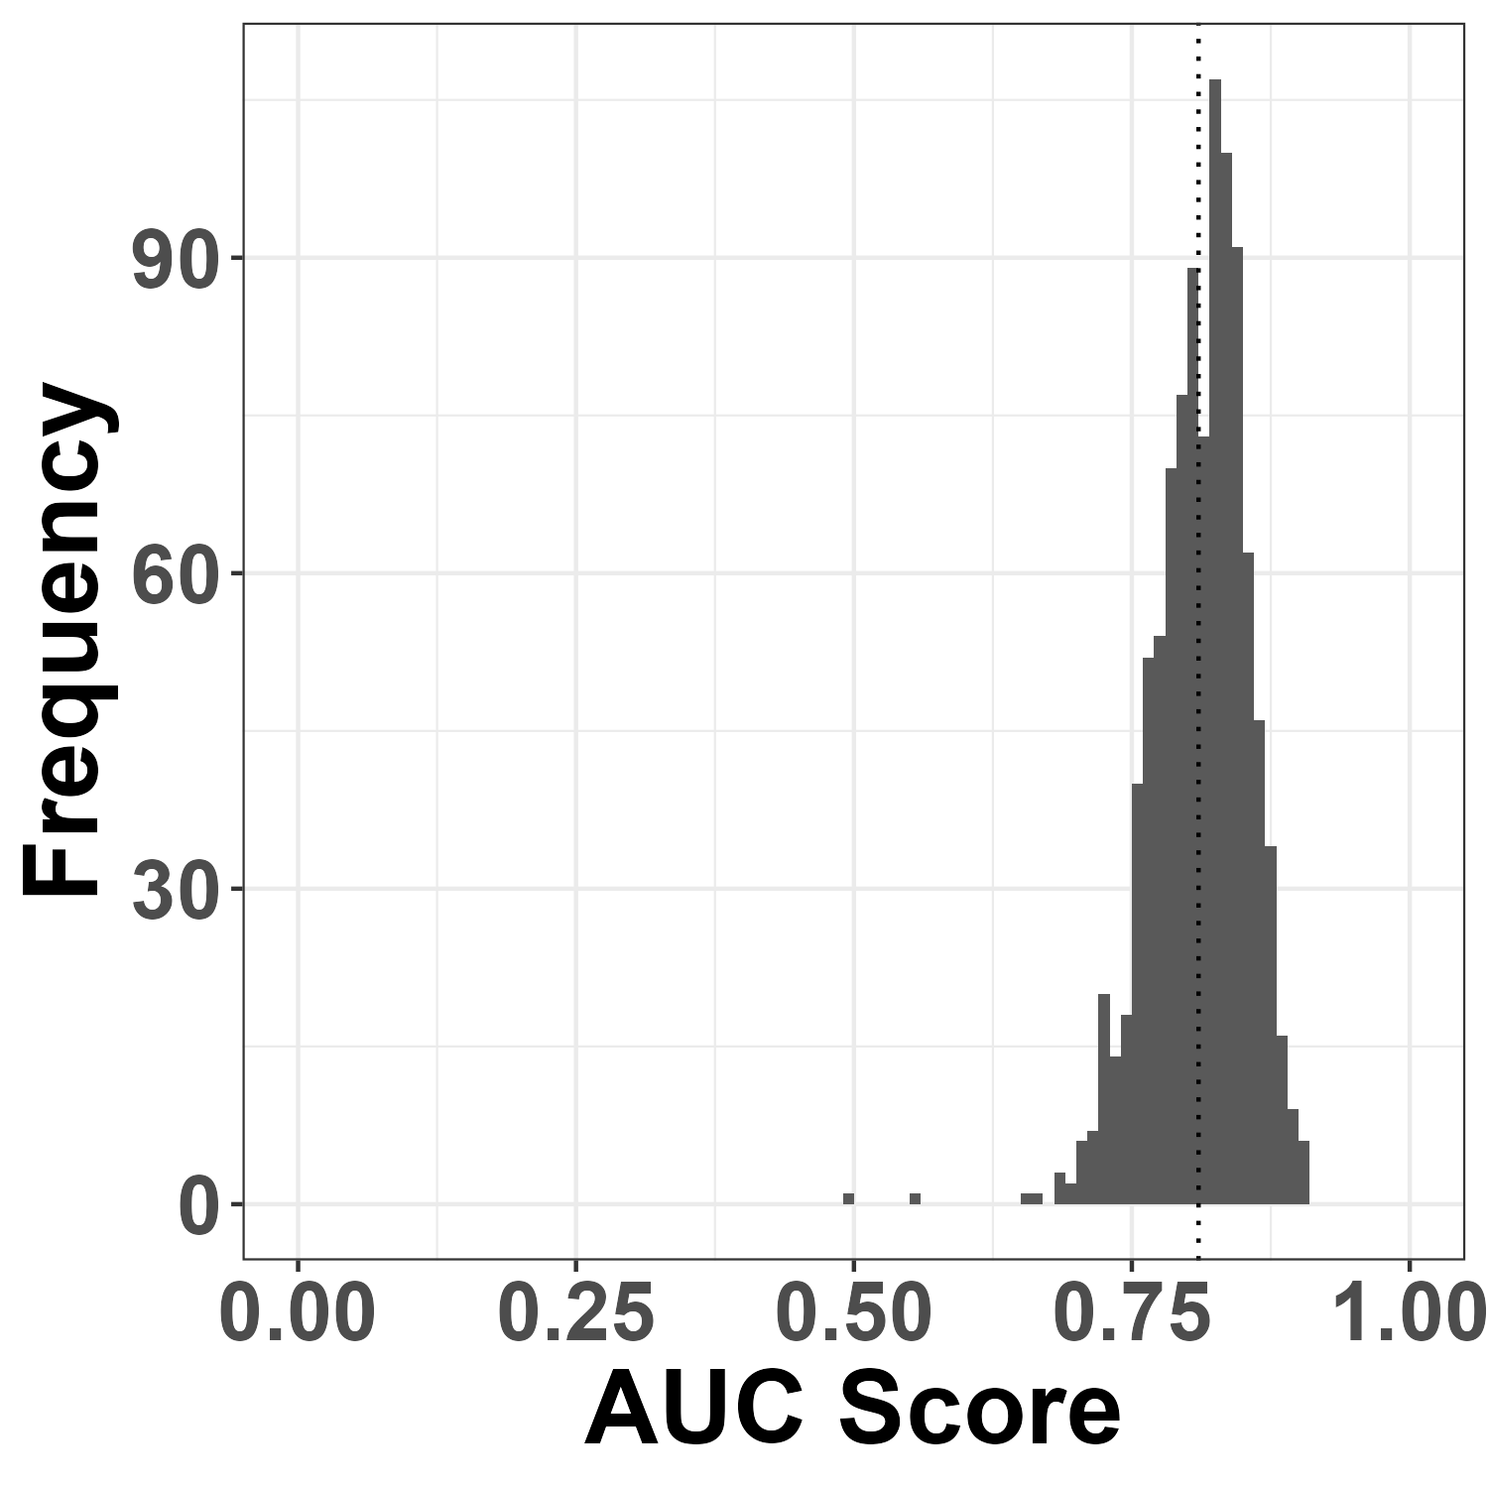
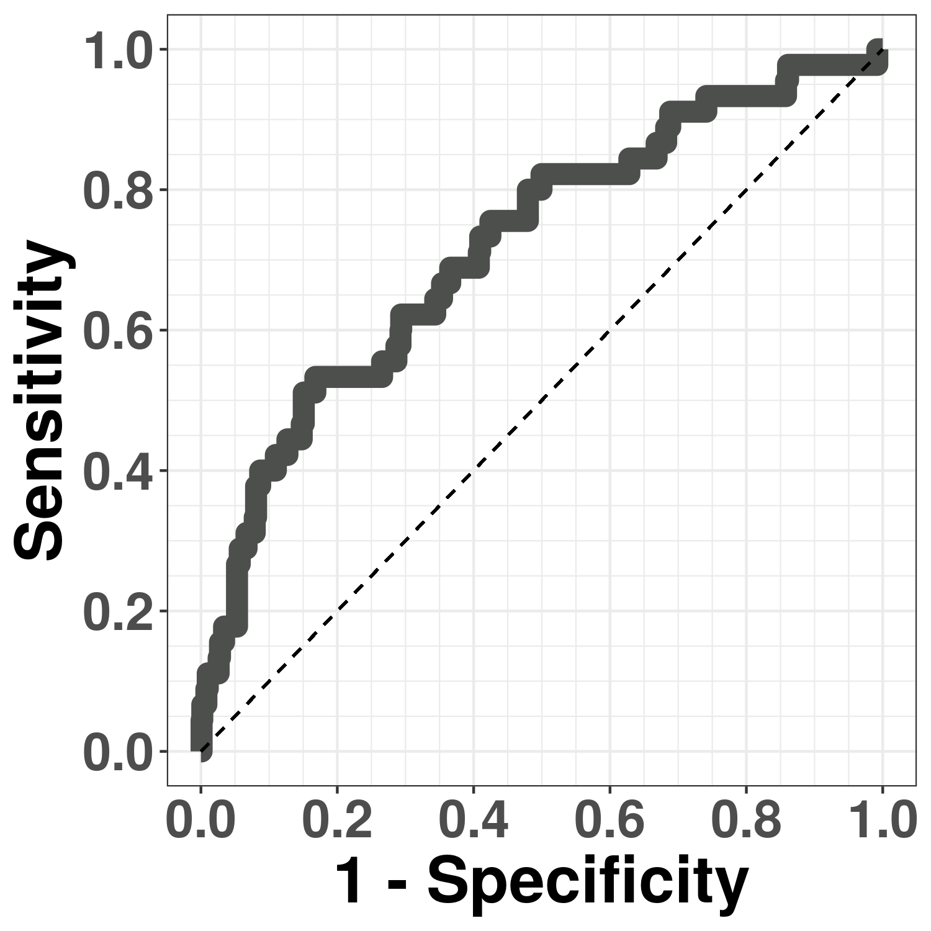
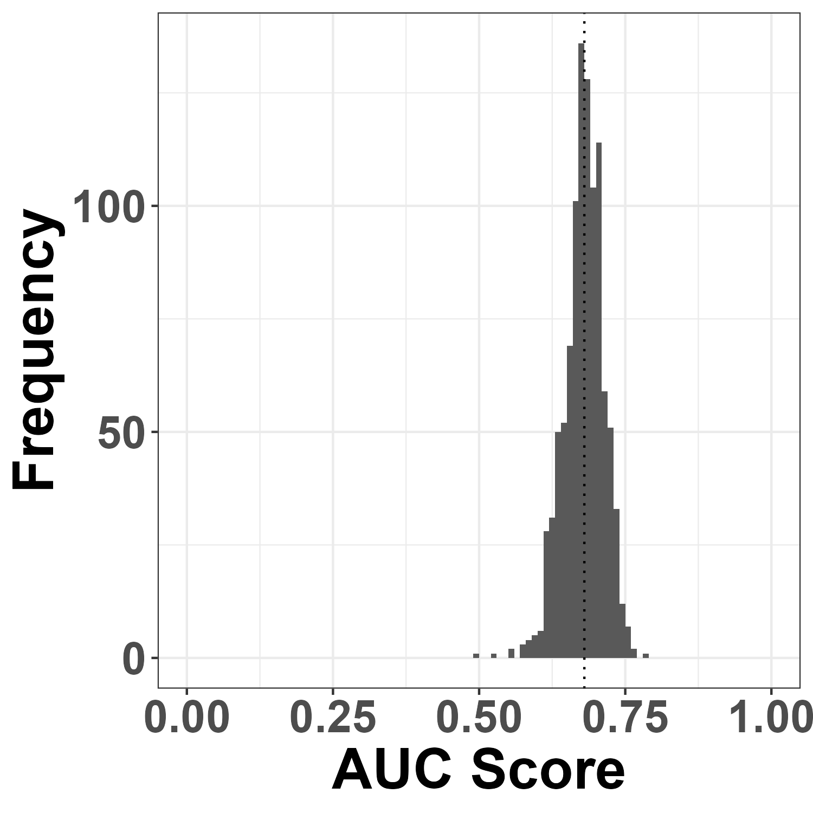

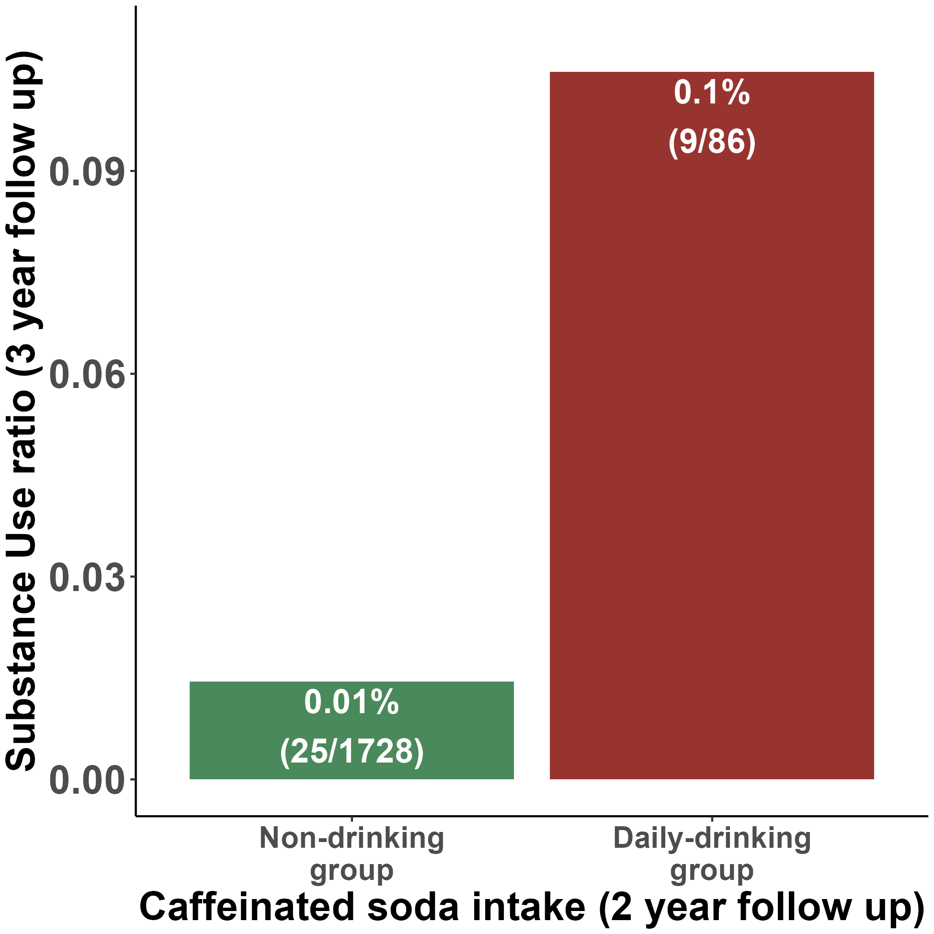

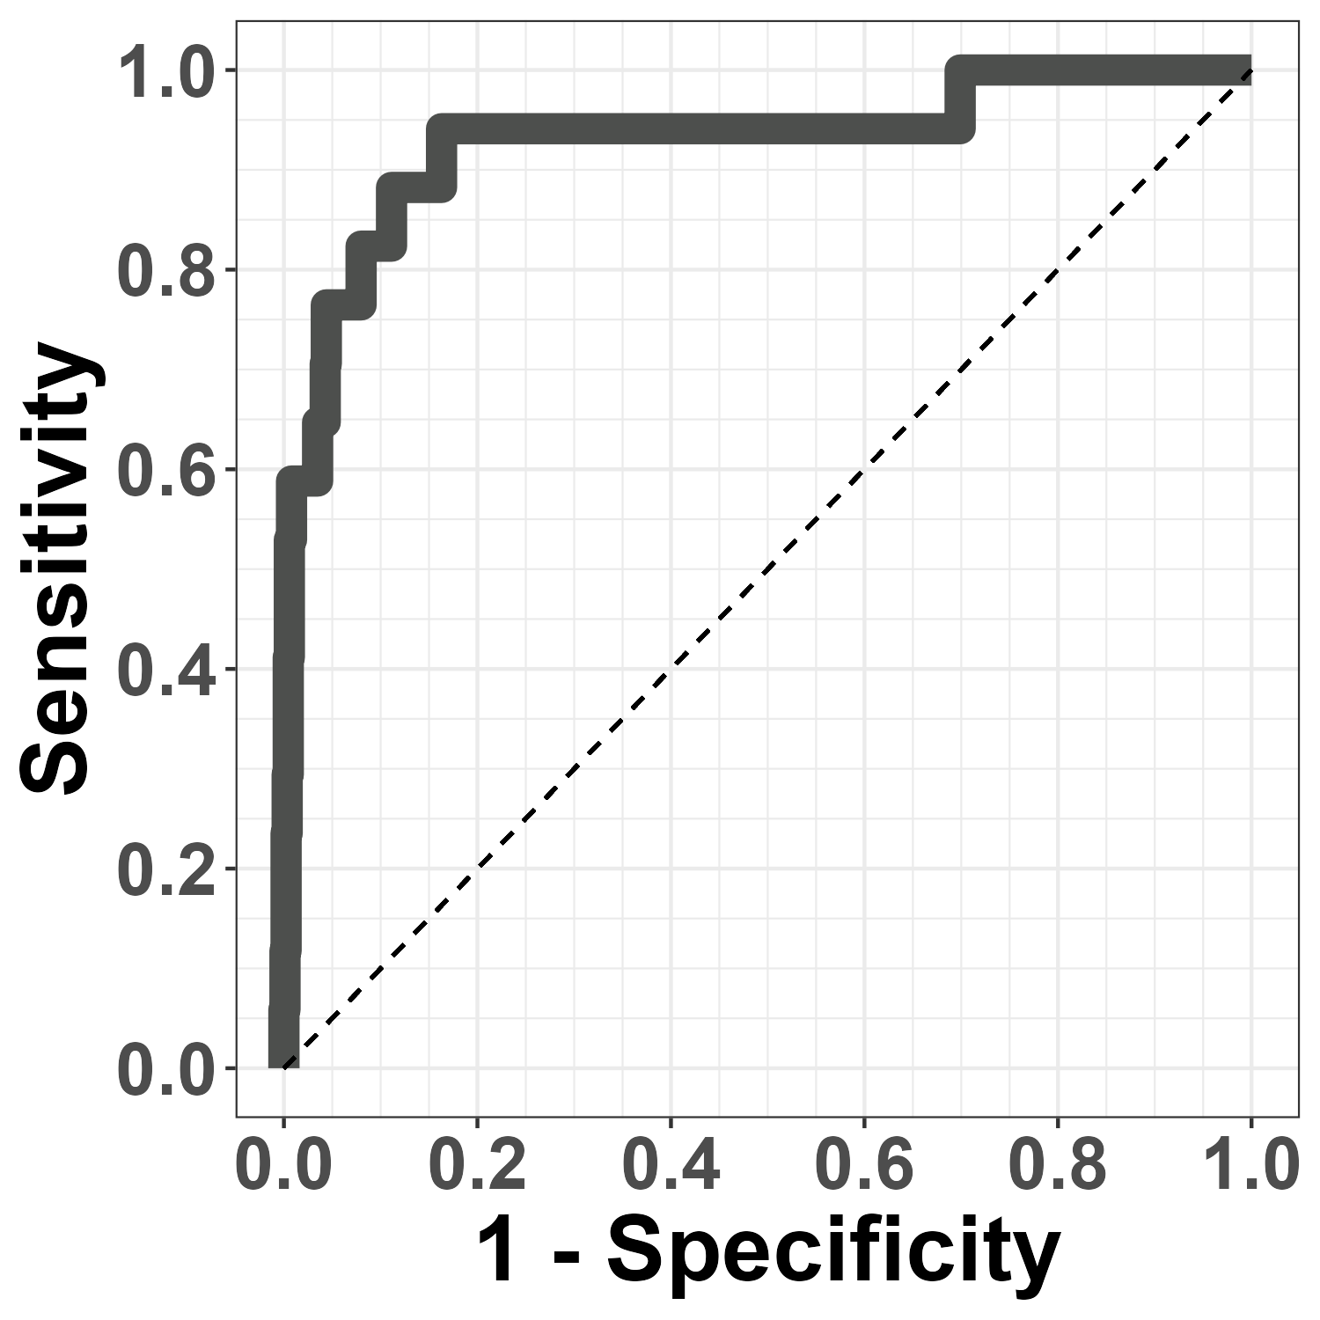
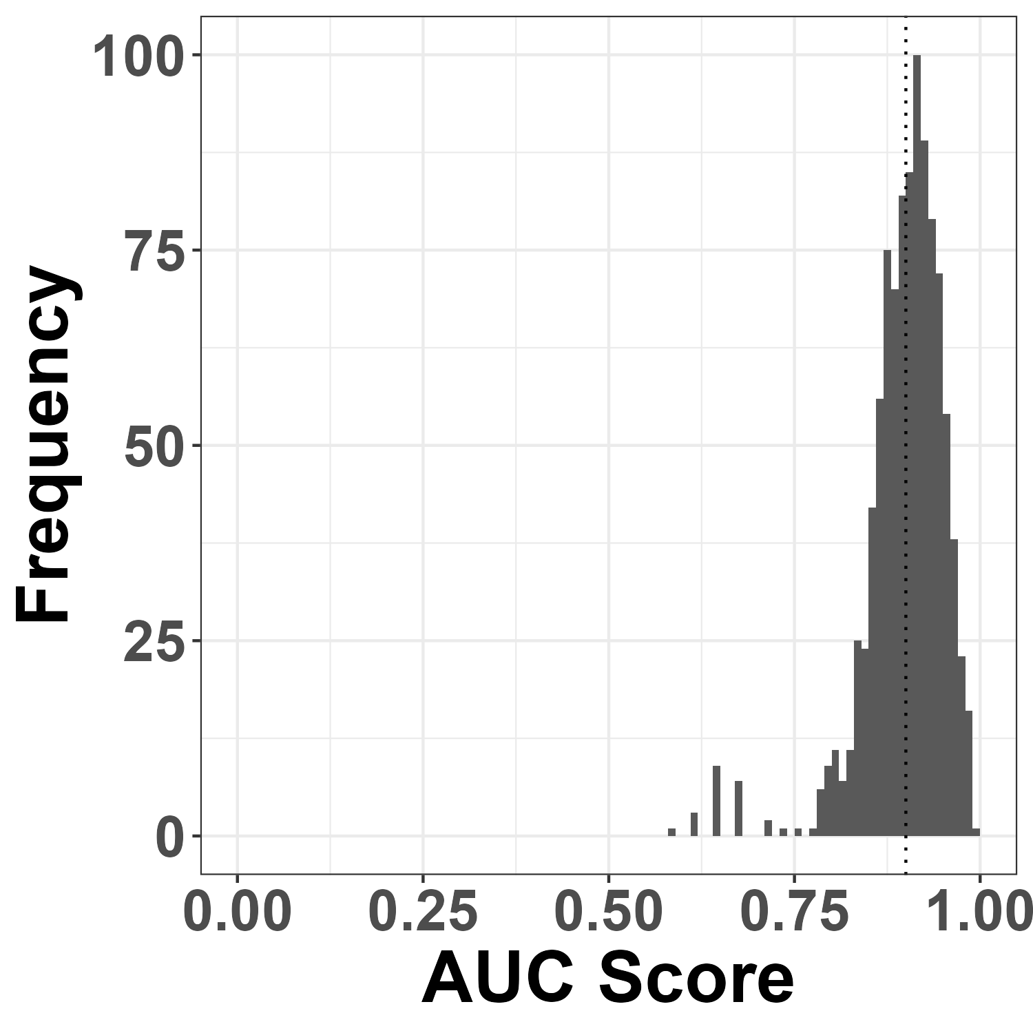
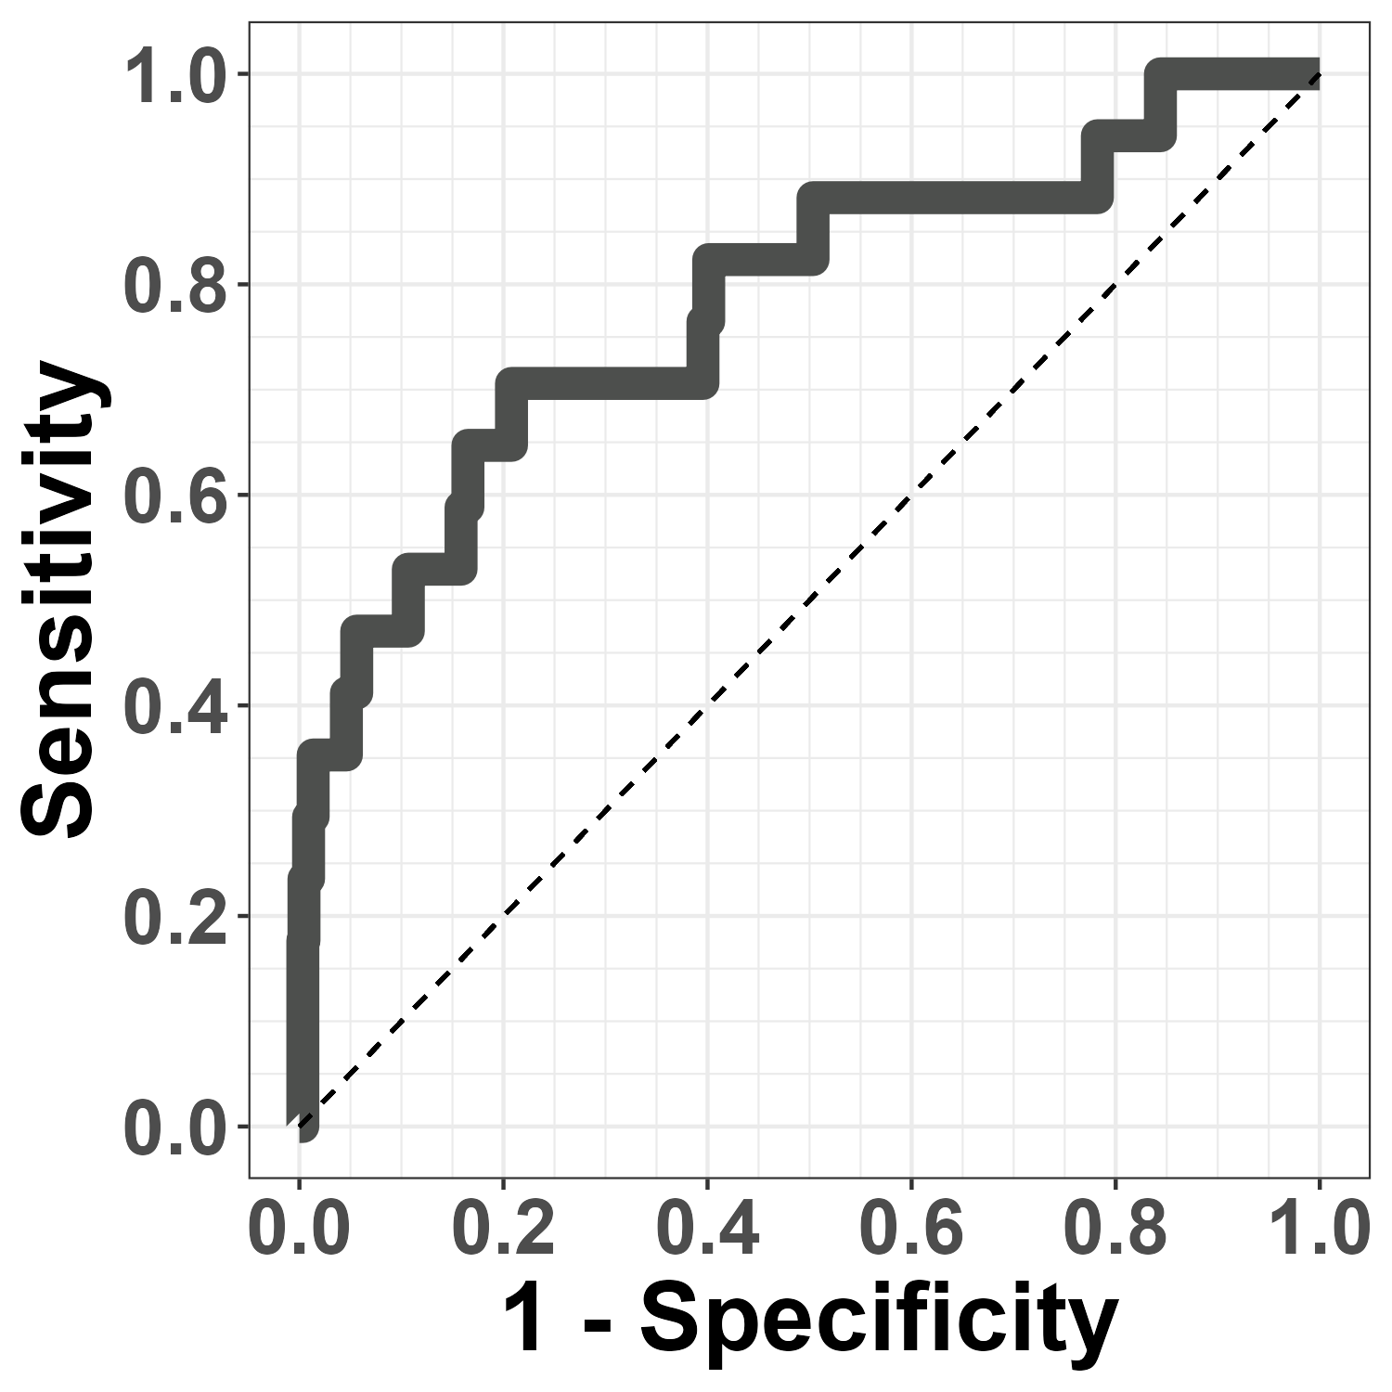
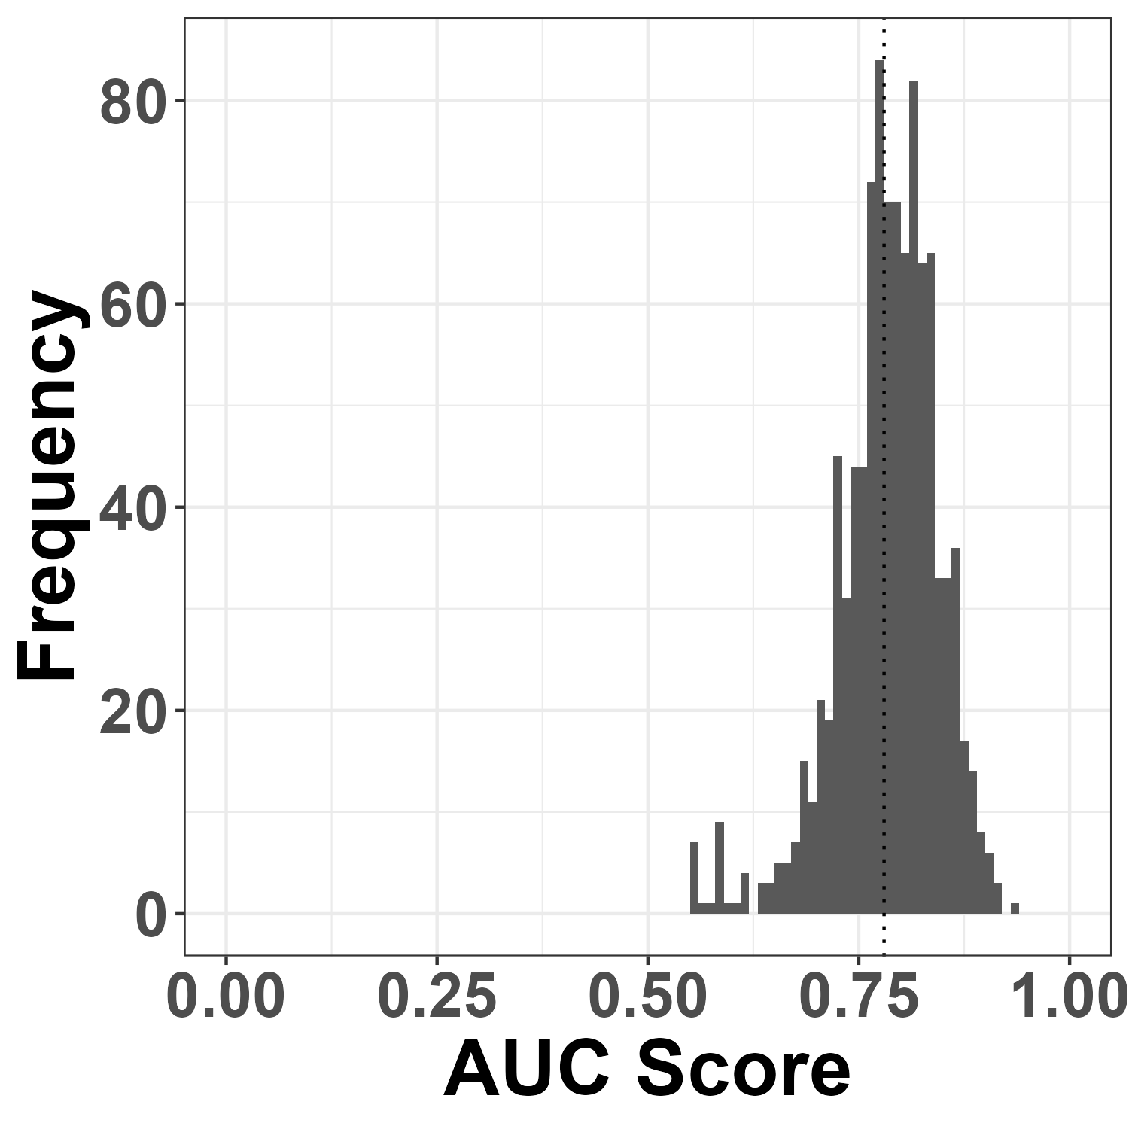
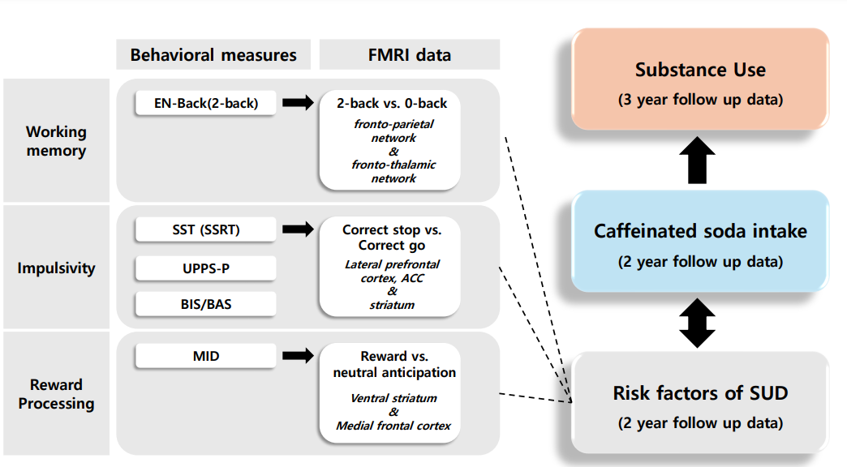

Caffeinated Soda intake
as a Predictor of Substance Use
in Adolescents
서울대학교 심리학과
안우영, 정유한
wjddbgks123@snu.ac.kr
INTRODUCTION
RESULTS
Mina Kwon et al(2024) shows
caffeinated soda¹⁾ intake is associated with future Alcohol sipping²⁾ for children.
How about heavier substance use?
(Substance use = Alcohol³⁾, nicotine, cannabis use)
¹⁾ e.g. Coke, Dr.pepper, Mountain Dew
²⁾ Alcohol sipping: one sip of alcohol
³⁾ Alcohol use: a full drink of alcohol
(A). neurobehavioral risk factors for SUDs predict caffeinate soda intake
Daily-drinkers (N=86) VS. Non-drinkers (N=1728)
Research Question
(A) Do neurobehavioral risk factors for SUDs predict caffeinated soda intake?
(B) Does caffeinated soda intake predicts future substance use(Alcohol, Nicotine, Cannabis use)?
Training Dataset
(Mean AUC score = 0.81)
Test Dataset
(Mean AUC score = 0.68)
PARTICIPANT / METHODS
(B). Caffeinated soda intake
predicts future substance use
Substance Users (N=34) VS. Non-Users (N=1780)
Data
Adolescent Brain Cognitive Development (ABCD) Study
2 year follow up data & 3 year follow up data
11~12 years old Adolescents
(N = 1814)
Method
Classification model using Lasso Regression
Training Dataset
(Mean AUC score = 0.90)
Test Dataset
(Mean AUC score = 0.78)
(B)
CONCLUSIONS
Caffeinated soda intake is a strong predictor of future substance use.
This result shows the potential risk of caffeinated soda intake to adolescents.
(A)
(A): Classification of caffeinated soda intake group
using neurobehavioral risk factors of SUDs
(B): Classification of Substance use group
Using caffeinated soda intake
REFERENCE
Kwon, M., Kim, H., Yang, J., Lee, Y., Hur, J. K., Lee, T. H., ... & Ahn, W. Y. (2024). Caffeinated soda intake in children is associated with neurobehavioral risk factors for substance misuse. Substance Use & Misuse, 59(1), 79-89.

